Slide 1
Jay’s 컨테이너 이야기..
그리고 OpenShift 4
Red Hat OpenShift
Sr. Technical Account Manager
Jooho Lee

Slide 2


Jooho Lee (Jay)
I am a senior OpenShift Technical Account Manager (TAM) in Toronto supporting middleware products(EAP/ DataGrid/ Web Server) and cloud products (Docker/ Kubernetes/ OpenShift/ Ansible). I am also an active member of JBoss User Group Korea and Openshift / Ansible Group.
LinkedIn: www.linkedin.com/in/jooho
Github:https://github.com/jooho
Blog: https://jhouse0317.tistory.com/category/RHEL
https://www.redhat.com/en/authors/jooho-lee
Youtube: BTBS - https://www.youtube.com/channel/UCmKLIAl-kjBSHqkX8m_HmIg

Slide 3

Jay’s
컨테이너 이야기?
해야할것도 많은데???

Slide 4

Global Transaction
라떼는...
이것을 다 직접 구현했어… Local Thread가... BlahBlah

Slide 5
기술의 역사를 알면 도움이 되는 구나
Beginner To BeginnerS
Beginner To BeginnerS
초심자가 초심자들에게...
Notes:
testetst

Slide 6

과거를 알면 미래가 보인다!

Slide 7
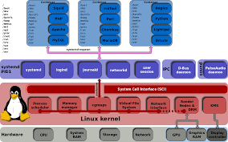
Google
2006년
Limiting/Accounting/Isolating Resource Usage
Process Containers
2008년
Merged to Linux 2.6.24
Changed to CGroups
<https://fr.wikipedia.org/wiki/Cgroups>

Slide 8

The first Linux Container Manager
LinuX Containers(LXC)
Using cgroups and Linux namespaces
Memory
CPU
I/O
NETWORK
DEVICE NODE
MNT(파일시스템)
PID(프로세스)
NET(네트워크)
IPC(SytemV IPC)
UTS(hostname)
USER(UID)

Slide 9




VM World
Conflict!

Slide 10



VM World

Slide 11

Container World
Namespace
Resources
LXC
Namespace
Resources

Slide 12

Google
2013년
LMCTFY(Let Me Contain That For You)
libcontainer under OCP
(Open Container Project)
<https://fr.wikipedia.org/wiki/Cgroups>

Slide 13

Game Changer!
2013. Mar. 20

Slide 14
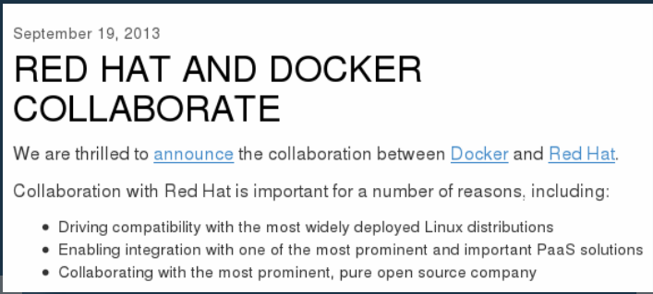
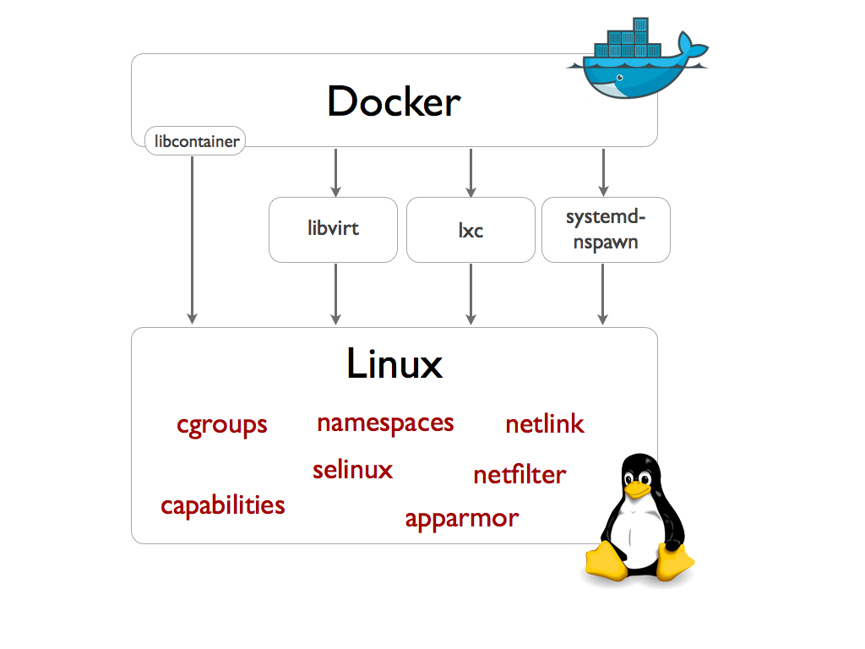


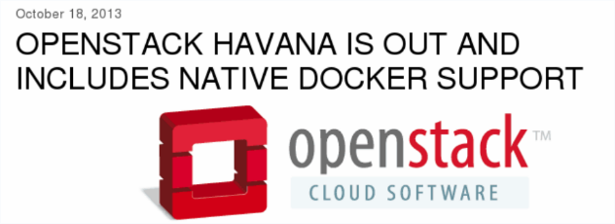
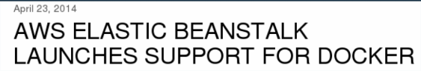
내가 여기에서 제일 잘 나가!

Slide 15

새로운 개념의 OS 등장!
강력한 Competitor의 등장!
Container를 위한 Lightweight Linux OS
2013. Oct. 3

Slide 16

절치부심!
절대강자 Google이 돌아왔다
Kubernetes
2014. June. 7

Slide 17

같은 하늘 아래
두개의 태양은 있을수 없는 법
Container Wars

Slide 18


VS
Docker
CoreOS
Docker is
container leader
CoreOS is
new container OS leader

Slide 19

RKT
CoreOS blasts Rocket rival at Docker
Claim’s Docker’s direction is ‘fundamentally flawed’
Notes:
지금까지는 Red Hat의 모습은 보이지 않네요.. 오픈소스의 강자가 그동안 가만있지 않았겠죠?

Slide 20

PAAS Leader 의 Face Off
같은 이름, 새롭게 태어난 제품
2015. June

Slide 21
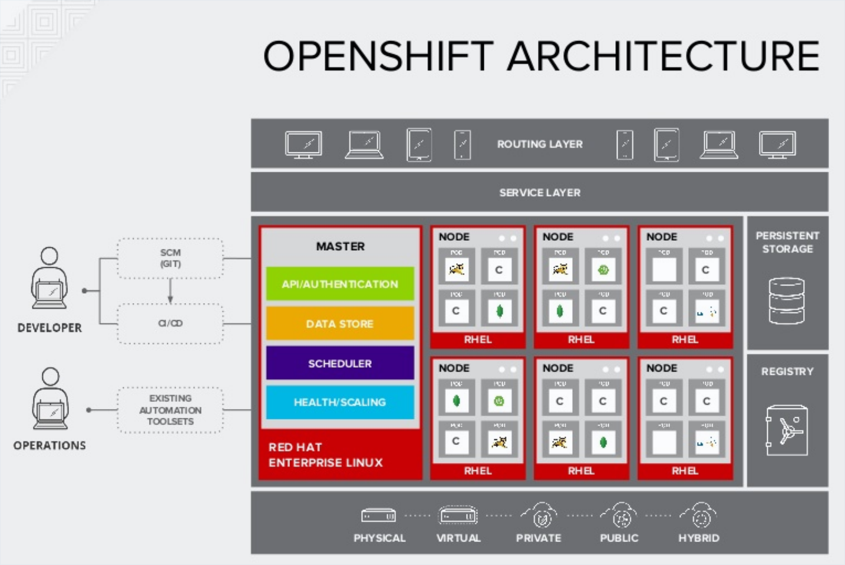

Slide 22
On Premises
Infrastructure
As A Service
Platform
As A Service
Software
As A Service
Applications
Applications
Applications
Applications
Data
Data
Data
Data
Runtime
Runtime
Runtime
Runtime
Middleware
Middleware
Middleware
Middleware
OS
OS
OS
OS
Virtualization
Virtualization
Virtualization
Virtualization
Server
Server
Server
Server
Storage
Storage
Storage
Storage
Network
Network
Network
Network
You Manage
Other Manage

Slide 23

아..놔..
너희는 왜 싸워가지고는...
Support
Support

Slide 24

Open Container Initiative
Established by Docker
Docker donate the implementation of OCI “RUNC”
Jun

Slide 25

Cloud Native Computing Foundation
open source software foundation dedicated to making cloud native computing universal and sustainable.
Established by Google
Kubernetes 1.0 is announced
Jun

Slide 26
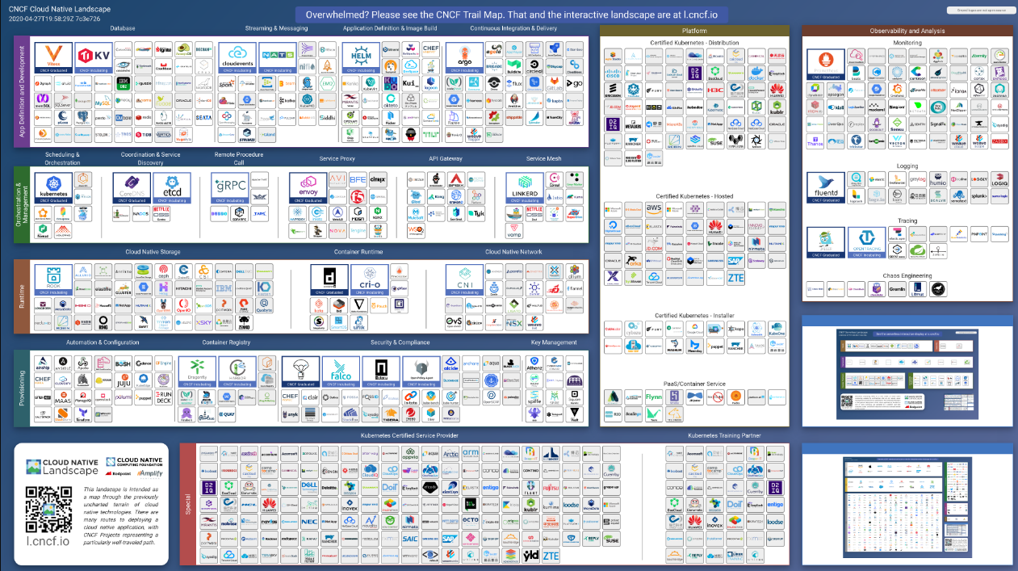

Slide 27
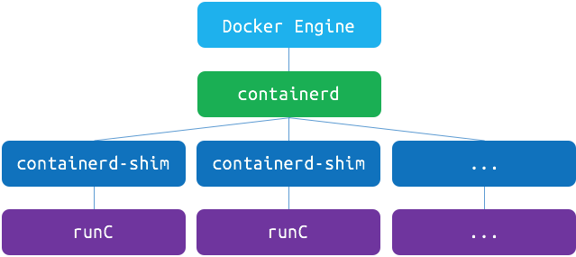
Docker changed Architecture for OCI
April

Slide 28



Google
Many Container Engines Out!
더이상
못해!
지원하라!

Slide 29

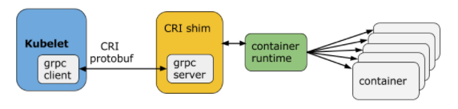
Container Runtime Interface
이제는 너희 차례다..
이젠 나를 따르라!
Kubernetes 1.5 introduced CRI
CRI-O/rktlet/frakti/docker CRI shim
Dec
Notes:
CRIO 발표

Slide 30
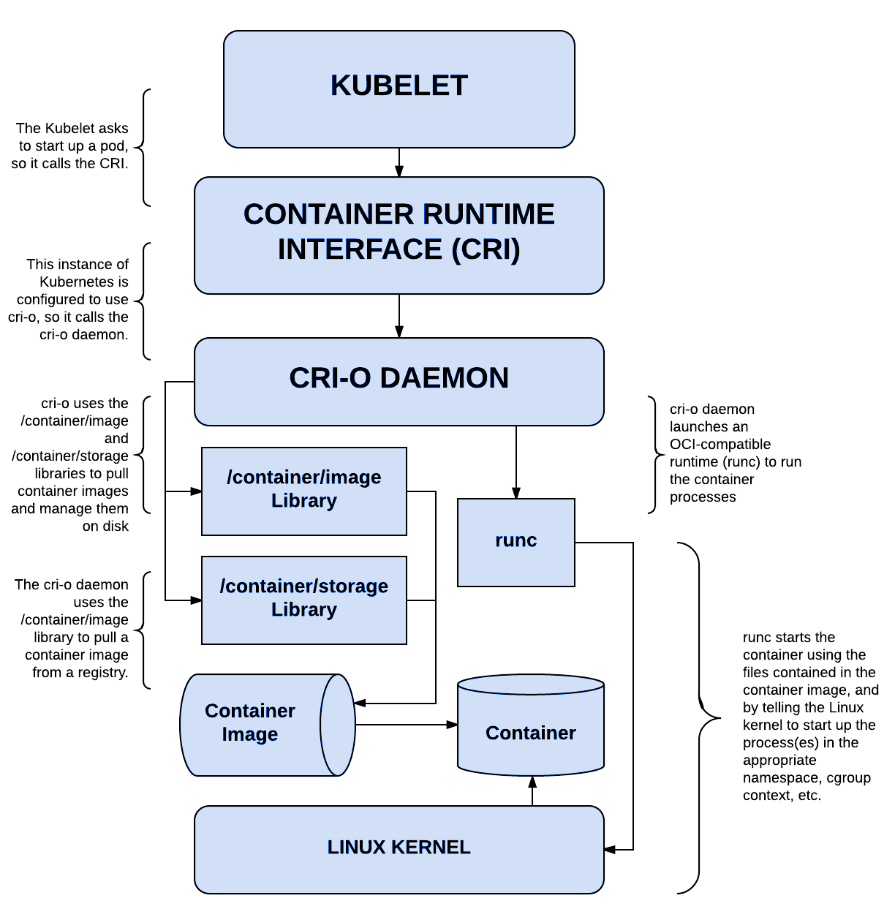
Red Hat release
new Implementation only for CRI
OCID (=> CRI-O)
CRI + OCI => CRI-O
OCI-compliant
runtimes and container images

Slide 31
Red Hat Acquire CoreOS
Bring CoreOS tech to OpenShift
Tectonic: Over-the-air update
Operator Framework: Application-specific controllers
Red Hat CoreOS: Container Linux
Red Hat Quay: Container Registry
Clair: Security Scanning

Slide 32
OpenShift 4 Platform
CLUSTER SERVICES
APPLICATION SERVICES
DEVELOPER SERVICES
Metrics, Chargeback, Registry, Logging
Middleware, Service Mesh, Functions, ISV
Dev Tools, Automated Builds, CI/CD, IDE
AUTOMATED OPERATIONS
KUBERNETES
Red Hat Enterprise Linux or RHEL CoreOS
Best IT Ops Experience
CaaS
PaaS
FaaS
Best Developer Experience

Slide 33





OpenShift Container Platform
4.4
Advanced Cluster Management
Multi-cluster Management Discovery ⠇Policy ⠇Compliance ⠇Configuration ⠇Workloads
Manage Workloads
Build Cloud-Native Apps
Developer Productivity
Platform Services
Application Services
Developer Services
OpenShift Container Platform
Service Mesh ⠇Serverless Builds ⠇CI/CD Pipelines
Full Stack Logging Chargeback
Databases ⠇Languages Runtimes ⠇Integration Business Automation 100+ ISV Services
Developer CLI ⠇VS Code extensions ⠇IDE Plugins Code Ready Workspaces CodeReady Containers
Cluster Services Automated Ops ⠇Over-The-Air Updates ⠇Monitoring ⠇Registry ⠇Networking ⠇Router ⠇KubeVirt ⠇OLM ⠇Helm
OpenShift Kubernetes Engine
Kubernetes
Red Hat Enterprise Linux & RHEL CoreOS
Physical
Virtual
Private cloud
Public cloud
Managed cloud
(Azure, AWS, IBM, Red Hat)

Slide 34



CRI-O Support in OpenShift
CRI-O tracks and versions identical to Kubernetes, simplifying support permutations
CRI-O 1.16
Kubernetes 1.16
OpenShift 4.3
CRI-O 1.17
Kubernetes 1.17
OpenShift 4.4
CRI-O 1.18+
Kubernetes 1.18+
OpenShift 4.5

Slide 35
OpenShift 4
Detail Architecture

Slide 36
Your choice of infrastructure
COMPUTE
NETWORK
STORAGE
Notes:
OpenShift runs on a variety of infrastructure platforms, from bare metal to private cloud to public cloud.

Slide 37
Workers run workloads
WORKER
WORKER
COMPUTE
NETWORK
STORAGE
Notes:
There are two types of hosts in an OpenShift environment. Workers are where user workload and various OpenShift components will land. Workers can be easily scaled and, on cloud providers, even scaled automatically based on cluster capacity.

Slide 38
Masters are the control plane
MASTER
COMPUTE
NETWORK
STORAGE
Notes:
The other type of host is the master. OpenShift uses 3 masters for high availability and cluster quorum. User workload does not run on the masters.

Slide 39
Everything runs in pods
POD
IMAGE
CONTAINER
CONTAINER
10.140.4.44
Notes:
The pod is the deployable and scheduleable unit in an OpenShift environment. While a pod may have more than one container, all containers in the pod share a single network namespace, and the pod receives a single IP address on the software defined network inside the cluster.

Slide 40

State of everything
MASTER
etcd
COMPUTE
NETWORK
STORAGE
Notes:
etcd is used to keep track of the state of everything in the cluster, from which users are logged in to where workload lives and more.

Slide 41

Core kubernetes components
MASTER
Kubernetes
API server
Kubernetes
services
Scheduler
etcd
Cluster Management
COMPUTE
NETWORK
STORAGE
Notes:
OpenShift is built on Kubernetes, and its core components are still there and directly accessible via Kubernetes’ APIs.

Slide 42

Core OpenShift components
MASTER
OpenShift
services
OpenShift
API server
Kubernetes
services
Operator Lifecycle Management
etcd
Web Console
COMPUTE
NETWORK
STORAGE
Notes:
OpenShift brings its own web console with special features for both administrators and developers. OpenShift makes its features available through its own API endpoints which follow the same standard as other Kubernetes APIs using Custom Resource Definitions. OpenShift also brings a full lifecycle management solution that’s deeply integrated which allows for seamless and automatic cluster upgrades from within the cluster itself.

Slide 43
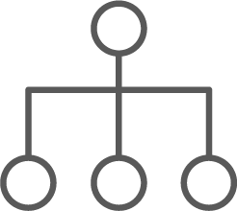
Internal and support infrastructure services
MASTER
OpenShift Services
Infrastructure
services
Monitoring | Logging | Tuned | SDN | DNS | Kubelet
Kubernetes
services
etcd
COMPUTE
NETWORK
STORAGE
Notes:
OpenShift includes a number of internal and support infrastructure services that make containers easier to use at scale.

Slide 44

Run on all hosts
MASTER
WORKER
WORKER
OpenShift Services
Infrastructure
services
Kubernetes
services
etcd
Monitoring | Logging | Tuned SDN | DNS | Kubelet
Monitoring | Logging | Tuned SDN | DNS | Kubelet
COMPUTE
NETWORK
STORAGE
Notes:
And, because these services all run in pods as part of the platform, they can be orchestrated like any other workload and made to run across all hosts in the environment.

Slide 45
Integrated image registry
MASTER
WORKER
WORKER
OpenShift Services
Infrastructure
services
Registry
Registry
Kubernetes
services
etcd
Monitoring | Logging | Tuned SDN | DNS | Kubelet
Monitoring | Logging | Tuned SDN | DNS | Kubelet
COMPUTE
NETWORK
STORAGE
Notes:
OpenShift includes an integrated container image registry. This registry is tied into OpenShift’s own role-based access control, providing multi-tenancy benefits. Images that are built inside the platform using OpenShift’s native build features automatically land in this image registry. Being a fully OCI-compliant registry, images created outside of the environment can also be placed into the integrated registry as part of a larger software devleopment lifecycle (SDLC) process.

Slide 46
Cluster monitoring
MASTER
WORKER
WORKER
OpenShift Services
Infrastructure
services
Registry
Registry
Kubernetes
services
Prometheus | Grafana Alertmanager
Prometheus | Grafana Alertmanager
etcd
Monitoring | Logging | Tuned SDN | DNS | Kubelet
Monitoring | Logging | Tuned SDN | DNS | Kubelet
COMPUTE
NETWORK
STORAGE
Notes:
OpenShift includes a cluster monitoring solution informed by the best practices of Red Hat’s own site reliability engineers (SREs). This preconfigured stack, based on Prometheus, Grafana, and Alertmanager helps platform administrators understand the health and capacity of the OpenShift cluster.

Slide 47
Log aggregation
MASTER
WORKER
WORKER
OpenShift Services
Kibana | Elasticsearch
Kibana | Elasticsearch
Infrastructure
services
Registry
Registry
Kubernetes
services
Prometheus | Grafana Alertmanager
Prometheus | Grafana Alertmanager
etcd
Monitoring | Logging | Tuned SDN | DNS | Kubelet
Monitoring | Logging | Tuned SDN | DNS | Kubelet
COMPUTE
NETWORK
STORAGE
Notes:
OpenShift also includes a log aggregation solution based on Fluentd, Elasticsearch, and Kibana. This integrated solution makes it easy to visualize and corroborate log events for applications that are scaled to many instances, and, it, too, is tied into OpenShift’s role-based access control (RBAC) ensuring that only the right people see the logs they are supposed to.

Slide 48
Integrated routing
MASTER
WORKER
WORKER
OpenShift Services
Kibana | Elasticsearch
Kibana | Elasticsearch
Infrastructure
services
Registry
Registry
Kubernetes
services
Router
Router
Prometheus | Grafana Alertmanager
Prometheus | Grafana Alertmanager
etcd
Monitoring | Logging | Tuned SDN | DNS | Kubelet
Monitoring | Logging | Tuned SDN | DNS | Kubelet
COMPUTE
NETWORK
STORAGE
Notes:
OpenShift extends Kubernetes ingress capabilities with an integrated router that bridges traffic from outside the cluster into the software defined network (SDN). This routing solution makes it easy for workload to be exposed and made accessible to consumers that are not inside the cluster.

Slide 49


Dev and ops via web, cli, API, and IDE
MASTER
WORKER
WORKER
OpenShift Services
Kibana | Elasticsearch
Kibana | Elasticsearch
SCM
(GIT)
Infrastructure
services
Registry
Registry
Kubernetes
services
Router
Router
Developers
CI/CD
Prometheus | Grafana Alertmanager
Prometheus | Grafana Alertmanager
etcd
EXISTING AUTOMATION TOOLSETS
Monitoring | Logging | Tuned SDN | DNS | Kubelet
Monitoring | Logging | Tuned SDN | DNS | Kubelet
Admins
COMPUTE
NETWORK
STORAGE
Notes:
Regardless of whether a consumer is an administrator or a developer, a rich set of web, CLI, and IDE integrations, all made possible by the Kubernetes and OpenShift APIs, means that people can work in the way they are most comfortable.

Slide 50

Another Game Changer
OPERATOR

Slide 51
An Operator is a method of packaging, deploying and managing a Kubernetes application.
You can think of Operators as the runtime that manages a specific type of application on Kubernetes.
Operators automate actions usually performed manually, reducing the chances for errors and simplifying complexity.
Kubernetes Controller Pattern
POD
POD
API Extension
Single-App Focus
Create/Delete
Replication Set
WATCH
POD
POD
POD

Slide 52
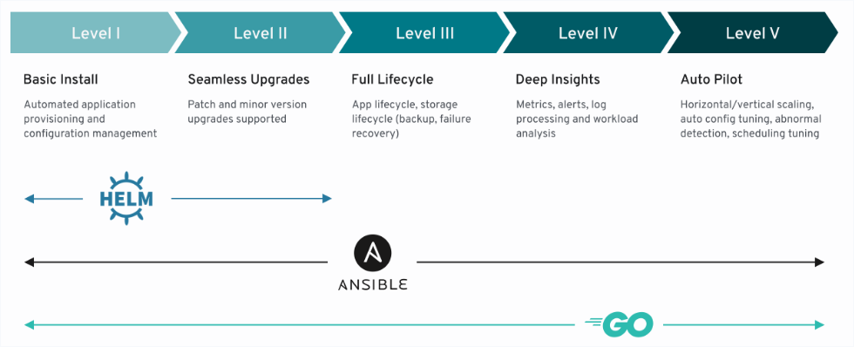

Slide 53
SDK
LIFECYCLE
MANAGEMENT
METERING

Slide 54



WHY OPERATOR FRAMEWORK?
UPDATE
PATCH
BACKUP
REBALANCE
SCALE
DEPLOY
STATEFUL APP
A WHILE
LATER
APP SERVICES OPERATIONS
DEVELOPER
UPDATE
PATCH
BACKUP
REBALANCE
SCALE
DEPLOY
STATEFUL APP
APP
OPERATOR
DEVELOPER

Slide 55
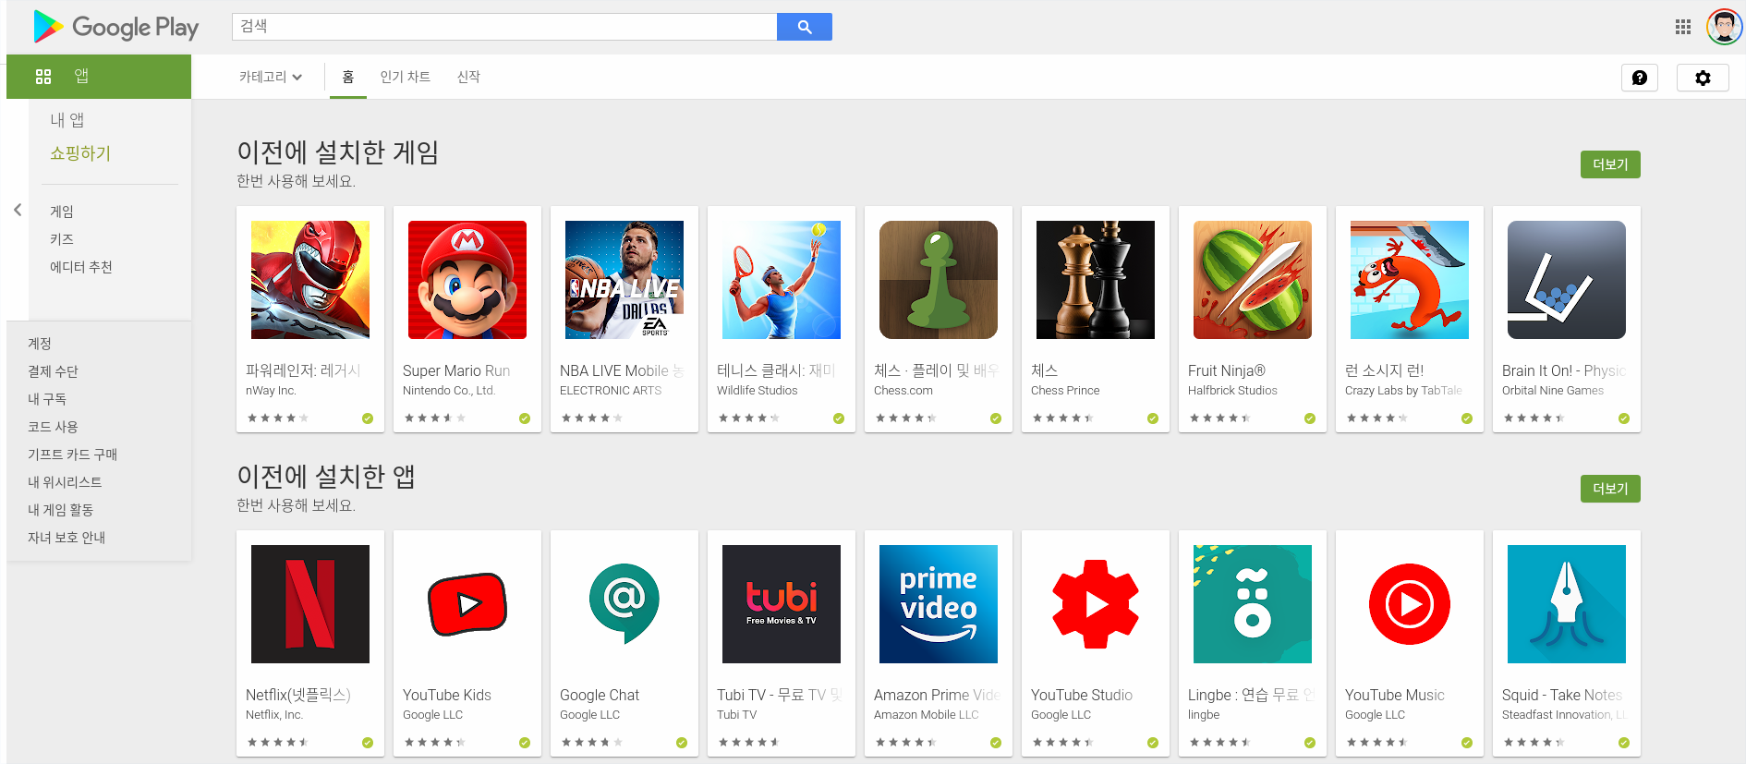

Slide 56
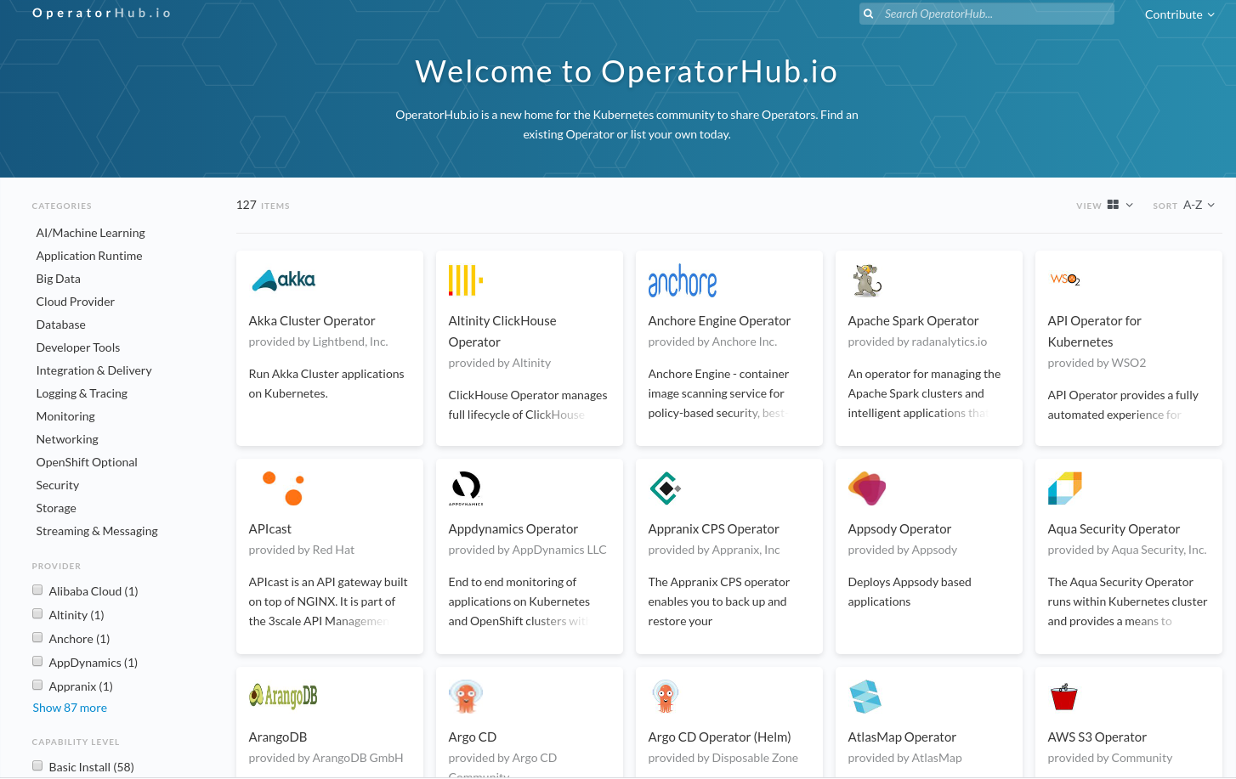

Slide 57
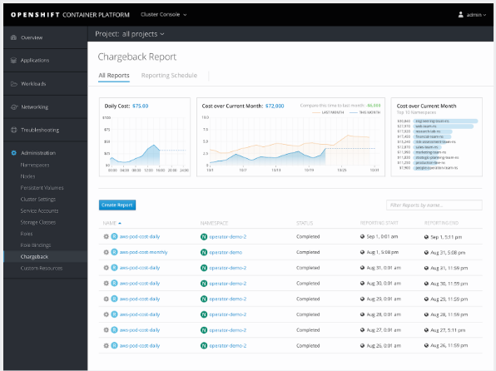

Slide 58
Demo
(NFS Provioner)

Slide 59


Persistent Volume(PV)
Persistent Volume Claim(PVC)
BIND
Persistent Volume(PV)
Persistent Volume Claim(PVC)
BIND
Storage Class
Sys Admin

Slide 60

VM 만들기
NFS Server용 Disk 붙이기
NFS Server 설치하는 법 찾기
StorageClass 연결
...
NFS Server
실수로 Service 삭제
실수로 NFS Storage 삭제
실수로…
Kubernetes upgrade로 app 변경
Don’t worry with

Slide 61
Scenario
Deploy NFS Provisioner Operator
Deploy NFS Provisioner
Create PVC
Created PV automatically
Delete NFS Server Service Object
Will recreate the Service Object

Slide 62
Demo
(Service Mesh)

Slide 63
Route
Service
Pod
Product Page
Product Page
Reviews
Reviews- v1
Reviews- v2
Product Page
Reviews- v3
Ratings
Ratings
Detail
Detail

Slide 64
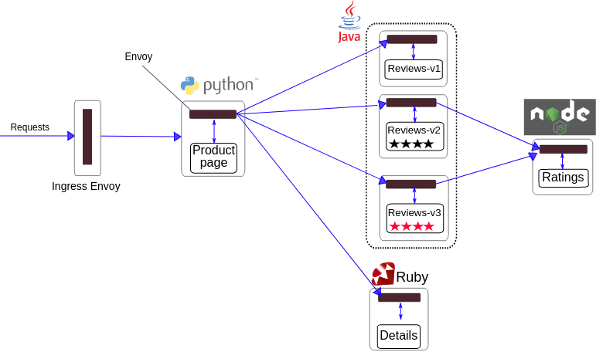

Slide 65
Scenario
Deploy Bookinfo application
Deploy Gateway/virtualService/DestinationRules and so on
Kiali Graph
Jason 은 언제나 Review v2만 보게 만듬

Slide 66
Demo Tutorial
Demo Script

Slide 67
감사합니다.

